Slide 1


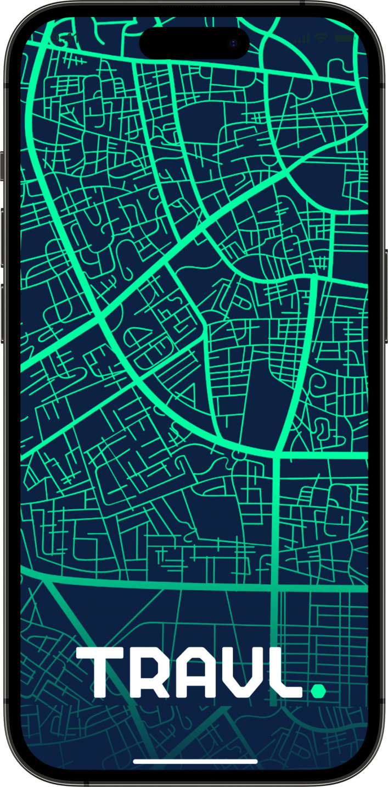
Hofstra
•
Summer Project.

Slide 2
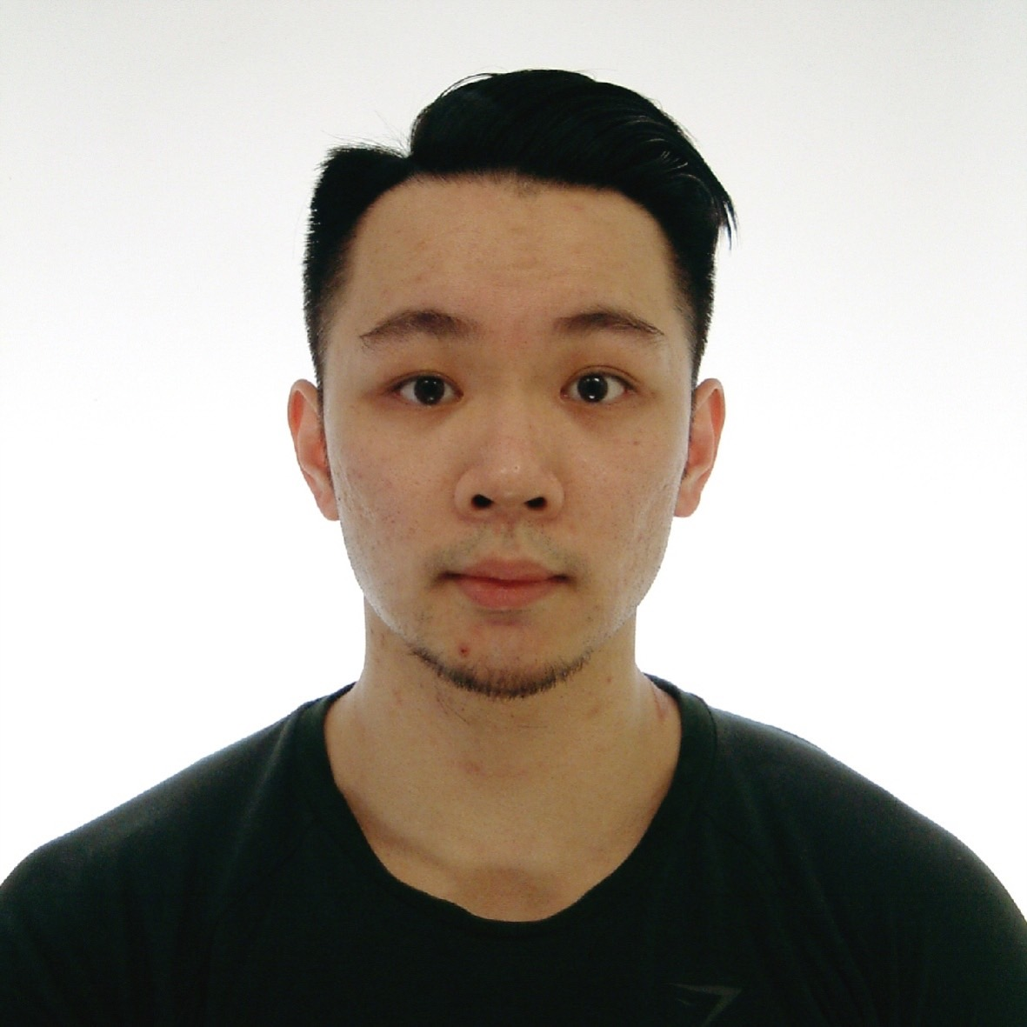
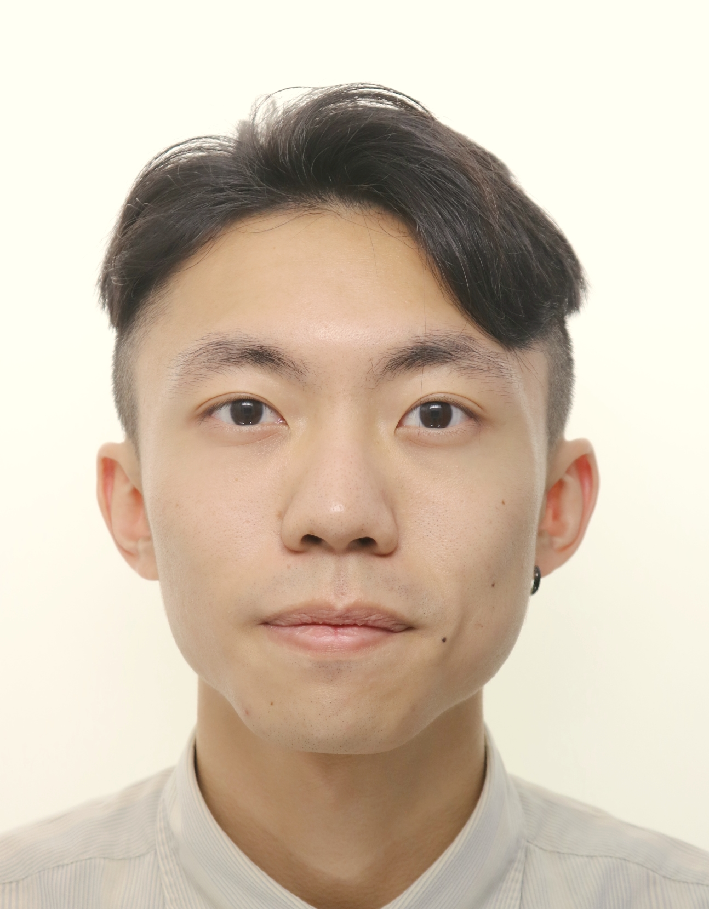
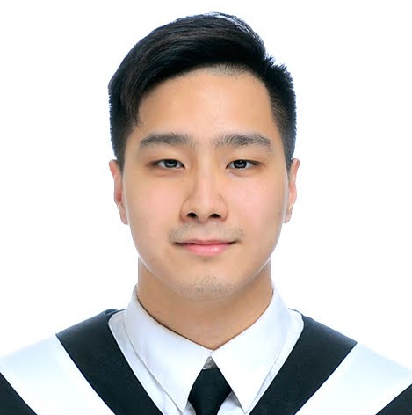
Hofstra
Our team
•
Who we are.
Benson Yang
Wilson Chou
Steven Hong
Developer
Developer
consultant

Slide 3




Hofstra
•
Main idea
Import Slide from User
Making script from GPT
Sent the script to User

Slide 4
Hofstra
•
Table of content
Project overview
Run through the initial idea
Key Objective
The main goals we are trying to achieve.
Steps
How we are going to make it work.
Discussion
Questions and discussions

Slide 5

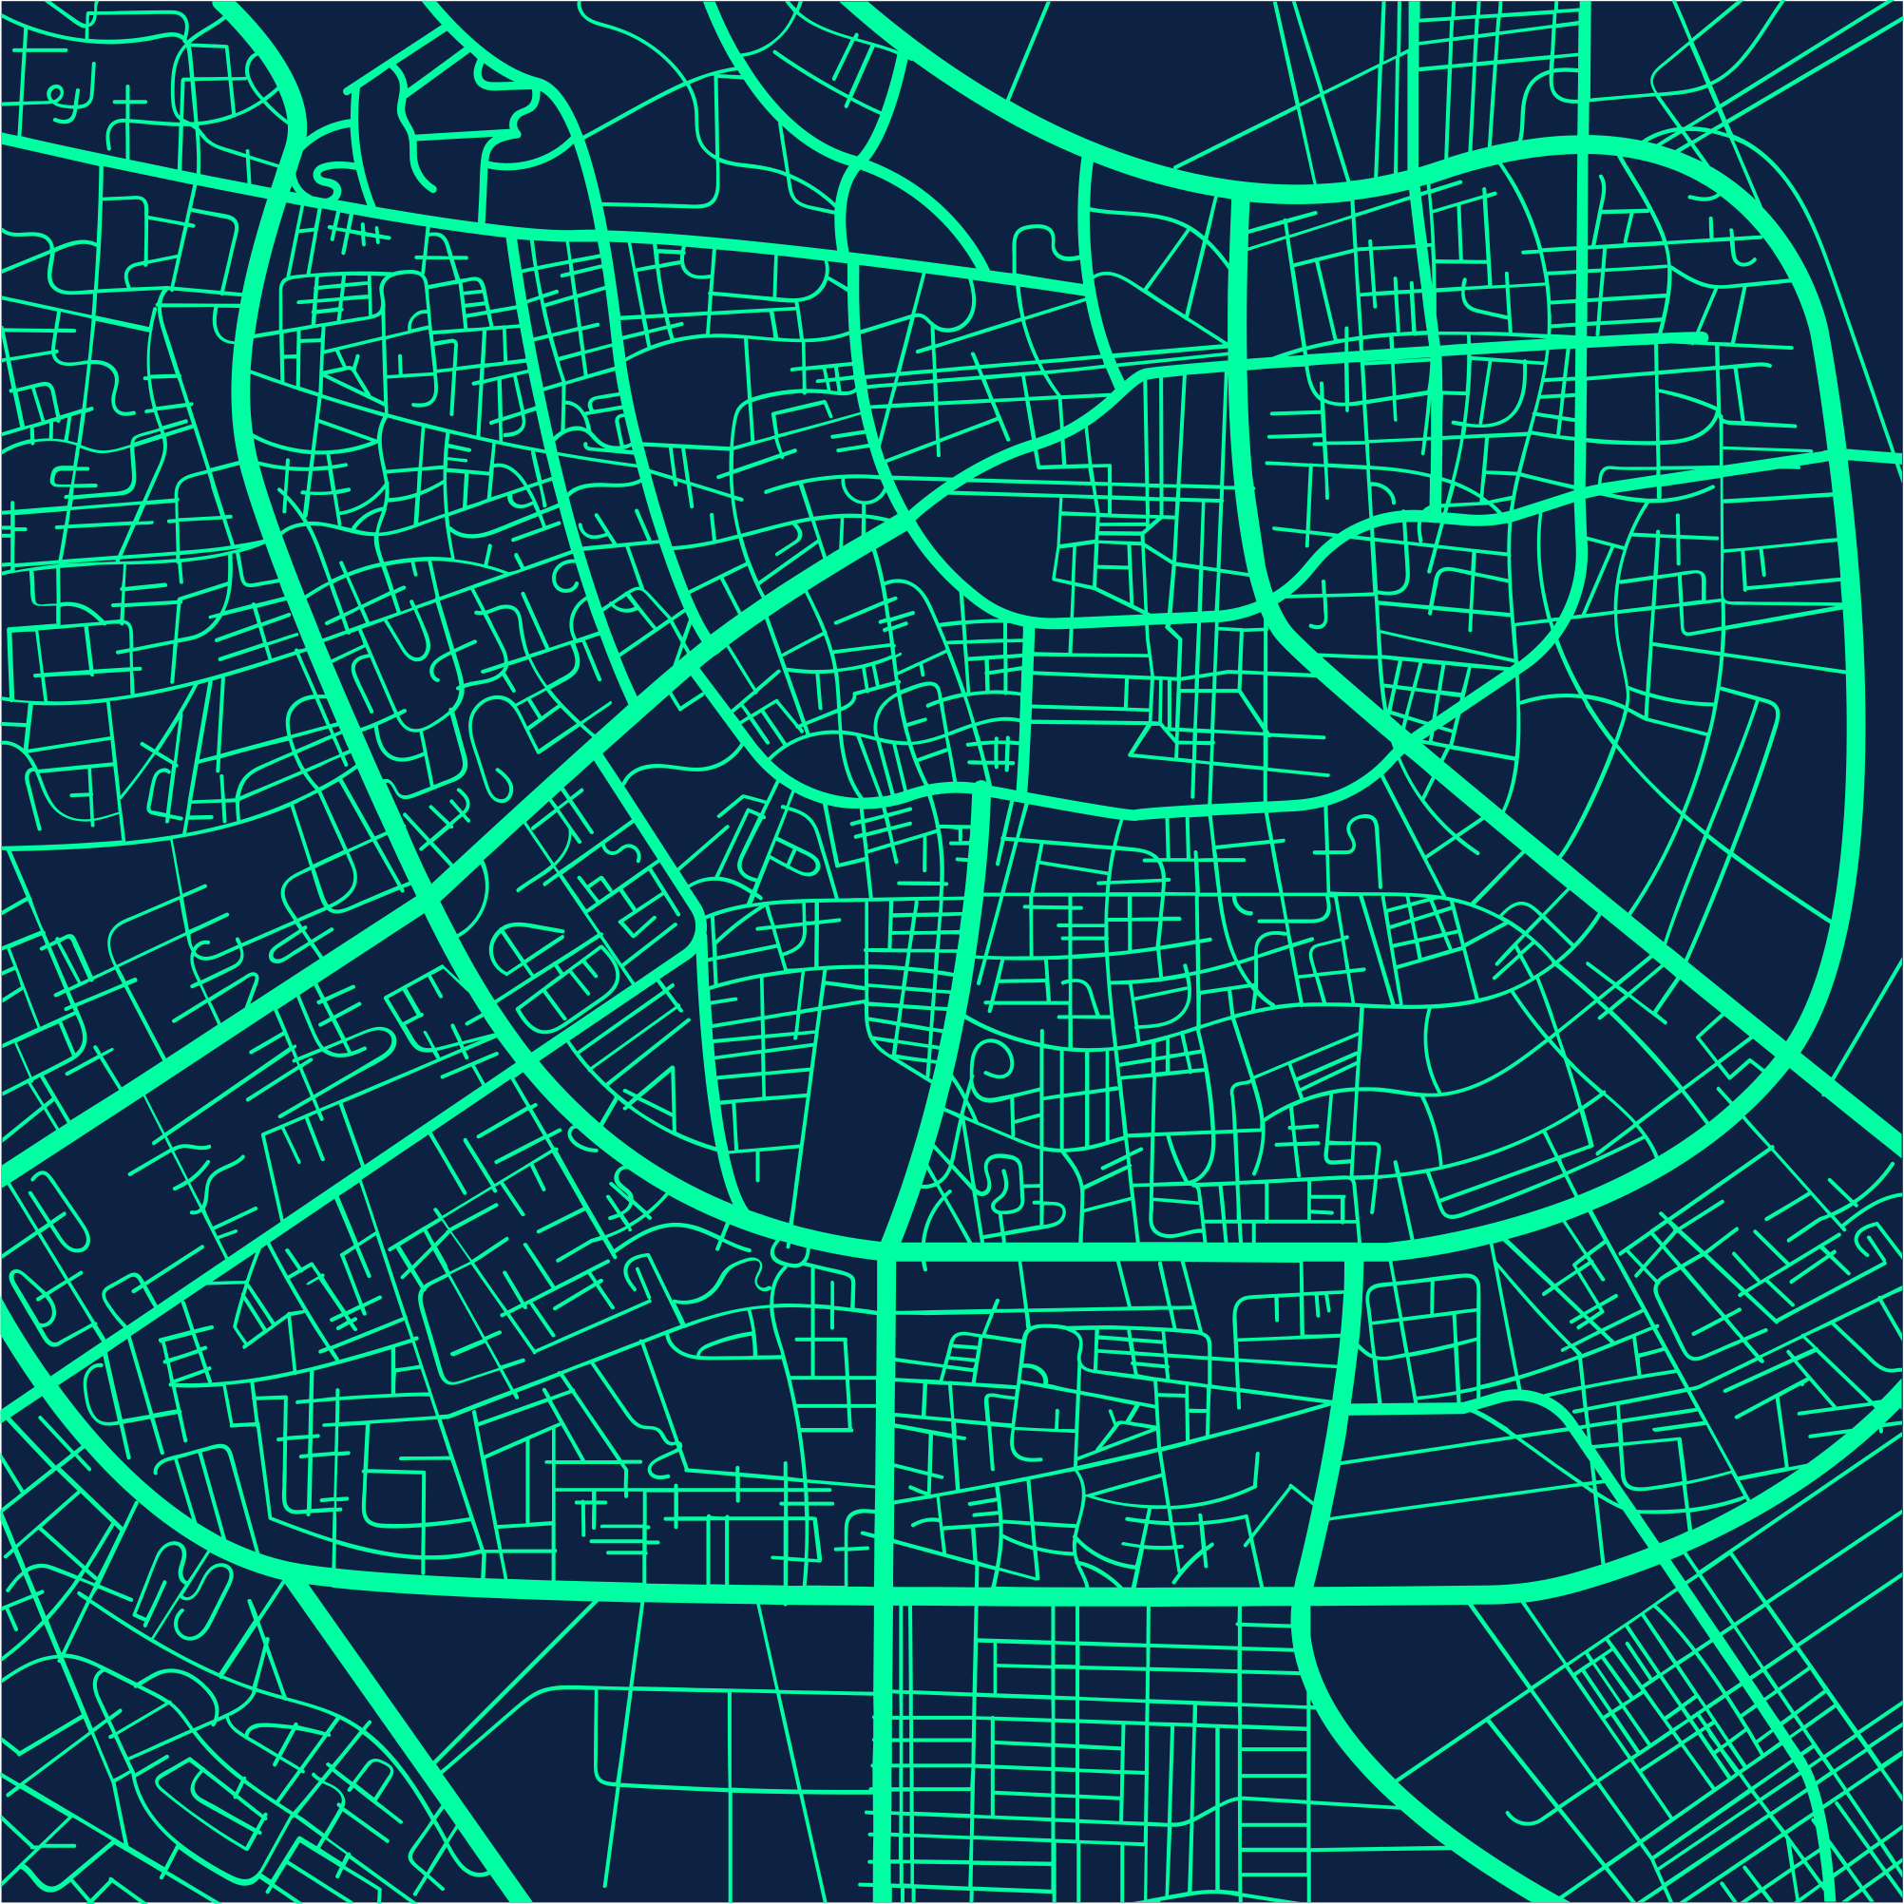
Hofstra
•
Project overview

Slide 6
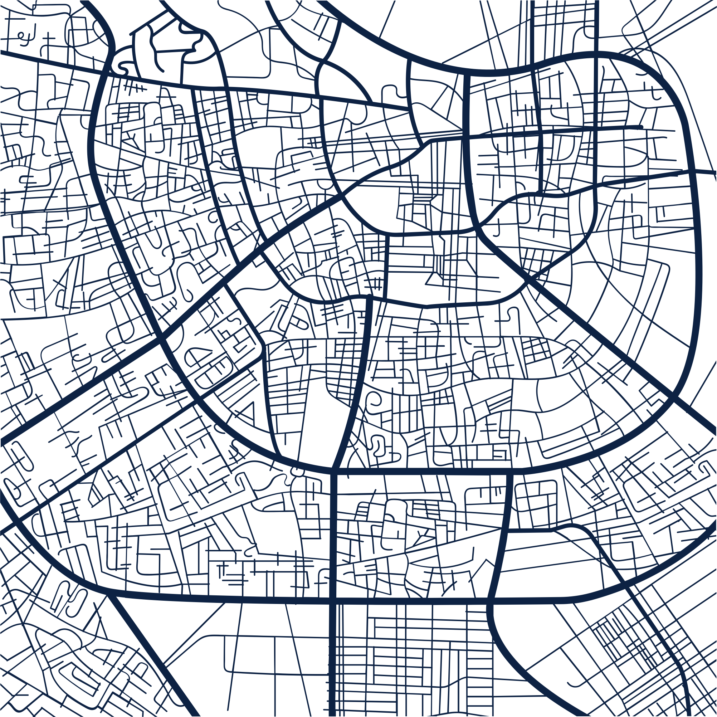
Hofstra
•
Why do we want to start this project?
•
AI VIral
Script importance
Summer Vacation
According to trend of the ChatGPT, we want to build up a project that is based on Open AI,
Also, we want to try using trendy machine learning technique.
We realized that script for every presentation is important.
An assistant to help people making a script could be pretty useful.
During summer vacation, we can discuss our viewpoint more stress-free.
Furthermore, we can have more free time to build up this project.

Slide 7

Hofstra
•
Key Objective.

Slide 8
Hofstra
•
What do we want to achieve?
We not sure the difficulty of this concept yet, but this is the main idea and latest solution.
•
GPT / MLP model
Teamwork simulation
Resume
Prompt (OpenAI API)
MLP (stable_baselines3 Library )
2 Engineer
1 consultant
We want to simulate project team working
Everyone in this group have their responsibility.
The ultimately goal of this project is to improve the competitiveness of resume

Slide 9
Hofstra
•
STEPS.

Slide 10
Hofstra
•
Steps – Part A
1
2
3
Slides grabing
Data modeling
GPT / API
Use the pptx package to collect data from the slide.
Use pandas package to save data and create specific formats.
Study the base model of Prompt (OpenAI API) and how to layout it to get good results.
* We will collect the returned values of each test (Excel?, DataBase?).

Slide 11
Hofstra
•
Steps – Part B (Optimize prompt)
1
2
3
4
Environment
Action Taken &
Reward
Observation &
Done
Testing
Use stable_baselines3 Library to create an Environment and train the script prompt.
Use a script template and put different strings (English words) in it.
sent it to the multiple GPT simulated judges for scoring. Higher scores positively
Lower scores rewarded negatively.
Check the scores of GPT judges summarize their comments on what can be done to improve the script.
Improve it and throw it back to GPT and check the score.
When this script can get higher than specific score.
Use Gym package to conduct a step test to see if the score given for each step has increased before and after training or not.
And record the stability.

Slide 12
Hofstra
•
Conclusion
Main Tech
Part A
Goal
AWS - EC2
Python - Pptx
Openai
Core tech. PDF & PPT are most popular material for presentation.
Therefore, this part is making a bridge that connect AI and presentation.
Main Tech
Goal
Part B
AWS - EC2
Python - Openai
Stable_baselines
Gym
Machine learning tech. Because our project is based on GPT API technique, we want to create something is built by our side.
This is not only improve the prompt which will sent to GPT, but also reduce the cost of connect the GPT.
* Part A, Part B can be develop at the same time.

Slide 13
Hofstra
•
Discussion.

Slide 14
•
Hofstra
•
Questions
Questions from us.
1.Tech support
2.Resource
3.External resource
Any questions professor.
Team discussion!

